Slide 1
Avoiding the Front Door

Slide 2


Who am I?
David Lodge, @tautology0

Slide 3
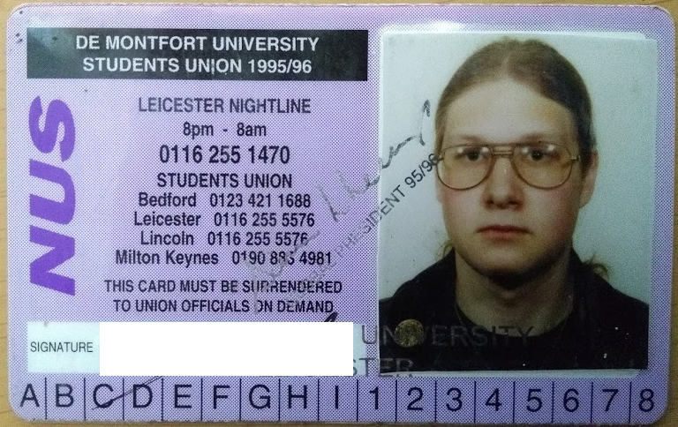
Who am I?

Slide 4

What is this about?
In media “hacking” is always through the front door
This is not realistic
The real world:
Social Engineering
Phishing
Wireless
Smokers’ entrance

Slide 5
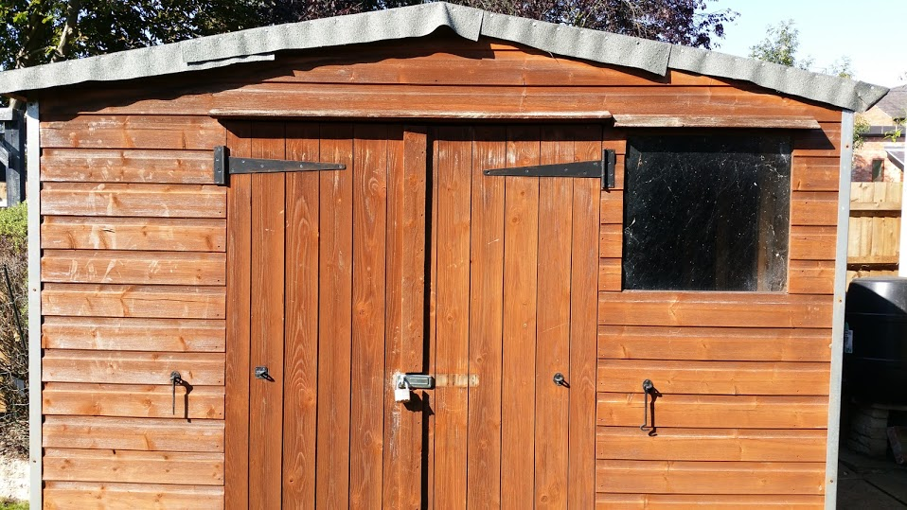

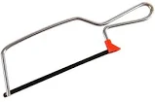
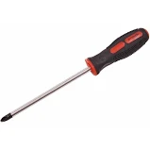
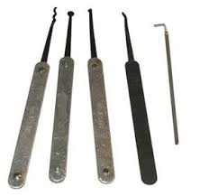
How would you gain access?
Bunch of Mates

Slide 6
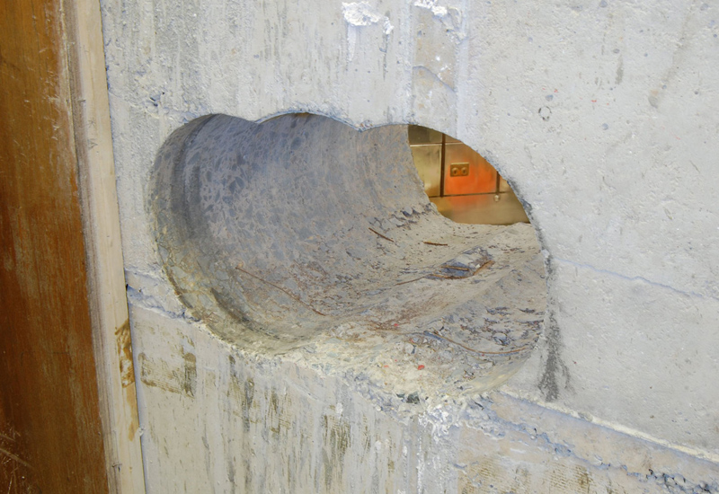

Take it further…
Normally try not to break stuff
What about if we ignore that rule?
What if we use a sledgehammer?

Slide 7
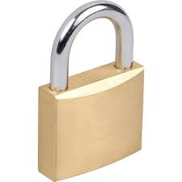
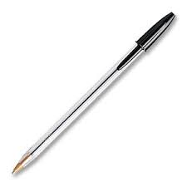
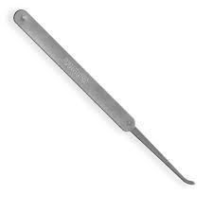
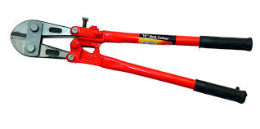
A quick demo
Here’s a normal padlock
It’s locking my bag
How can I get it open?

Slide 8
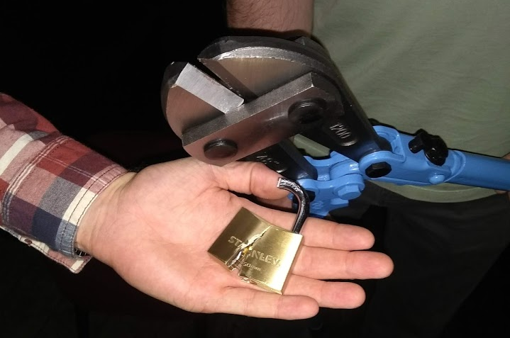
We can take this to silly levels

Slide 9
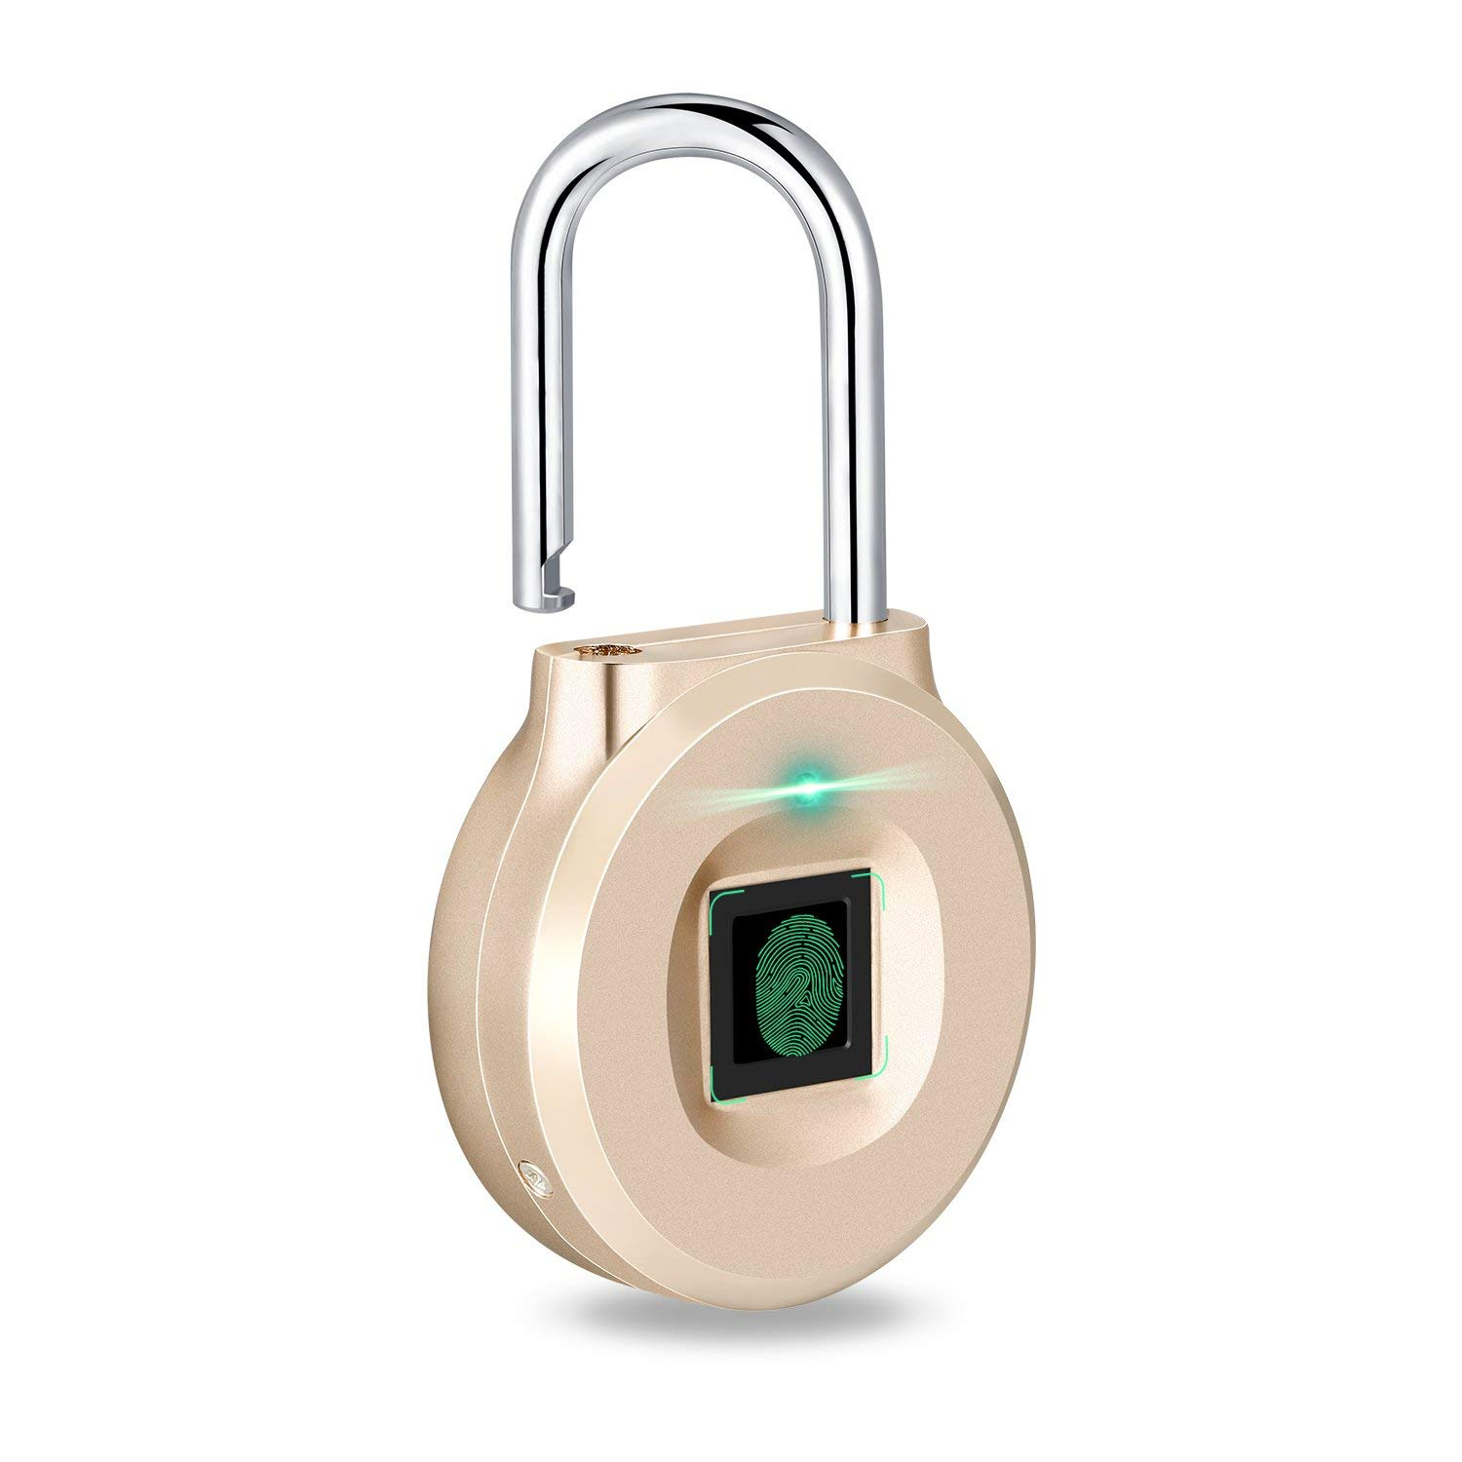
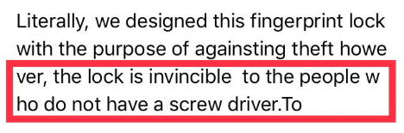
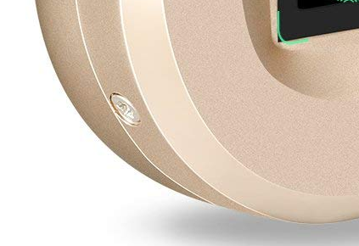
Smart Padlocks
On the right is an Uervoton padlock
@LockPickingLwyr did a video showing its design flaw
Yes, it’s held together with three torx screws
Once unscrewed we have access to the catch and can open it
Uervoton were asked about this and responded:

Slide 10
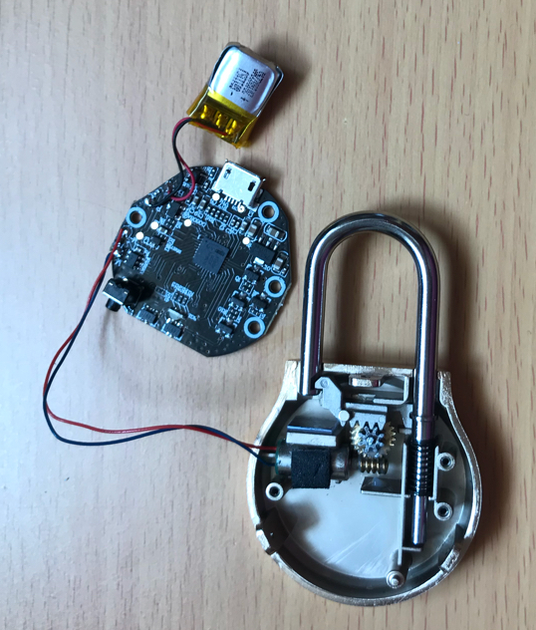
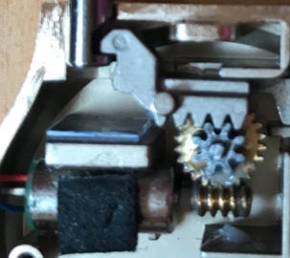
Smart Padlocks
This makes it easy to take apart to see how it works:
Notes:
We can see the mechanical bits here – basically a motor which gets transformed to move a catch back and forth. The shackle is spring loaded, so when the catch is released it pops open. This is how most “smart padlocks work”: the circuit board does the detection and then turns the motor to lock or unlock.
Also, notice this. That’s a magnet used to detect whether the device is opened, but if we have a suitable magnet (whip out earth magnet) we should be able to open it.

Slide 11
Attack Vectors
What can we attack:
The body
The shackle
The latch
The motor
The unlocking sensor
BLE
Fingerprint
The charging port (USB? Of course it doesn’t enumerate)
More
Notes:
Here we can enumerate the attack vectors – we’ve seen some of these attacks and some are beyond the scope of this talk

Slide 12
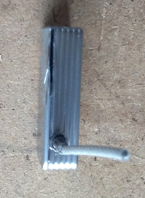
The body
Most IoT padlocks use a Zinc alloy (e.g. the Zamak family)
Good for casting, not for hardness
Using a small handheld electric saw (Dremel)
Need to be careful to avoid the battery
Low melting point

Slide 13
Video removed

Slide 14
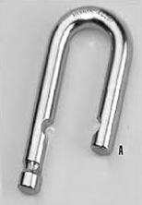
The shackle
I.e. the loopy bit
This is normally the hardest bit of the padlock
But can often be a bit of wire
As we have seen, vulnerable to force, as long as your tool is big enough
Notes:
An example from a cheap Fipilock

Slide 15
The shackle
Video removed
Notes:
An example from a cheap Fipilock

Slide 16
The latch
This is the bit that locks the latch in place
Potential vectors are:
Shims
Magnets
Percussive testing
Brute force

Slide 17
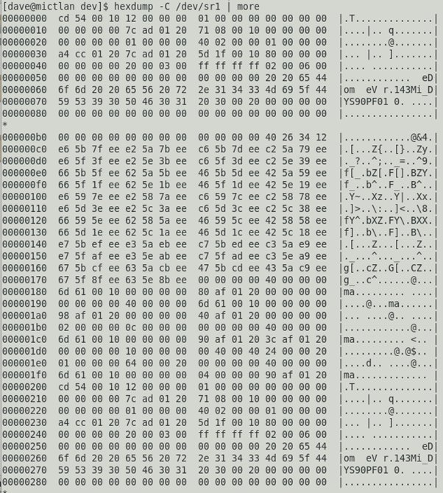
USB
Devices have batteries
Need to charge them
USB connections still have data cables
Raw feed from sensor?
More exploration needed
Notes:
The Fipilock actually has a data connection, but you don’t normally see it as the USB-C cable supplied with it only provides power!

Slide 18
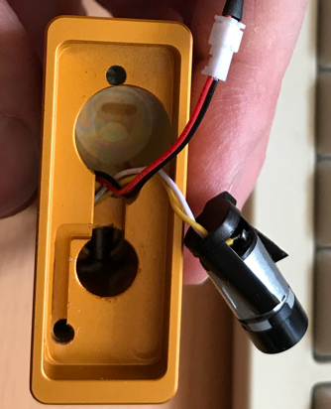
The motor
The motor connects to the logic board by two wires
Bypass the logic and do this by hand?
Just need:
A steady hand
A sharp implement
A battery
Notes:
Demo on a nokelock – the screw are on the outside “hidden” under a rubber bung.

Slide 19
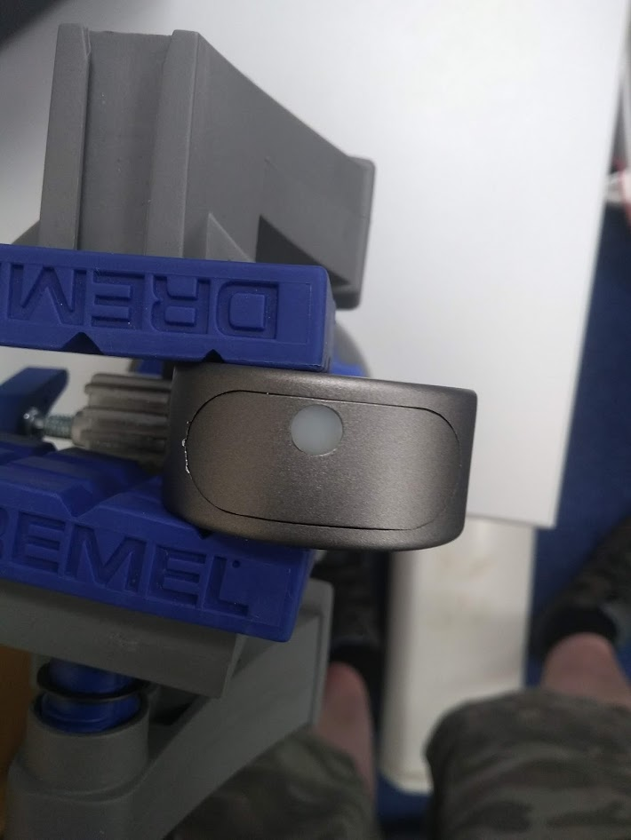
In Pictures

Slide 20
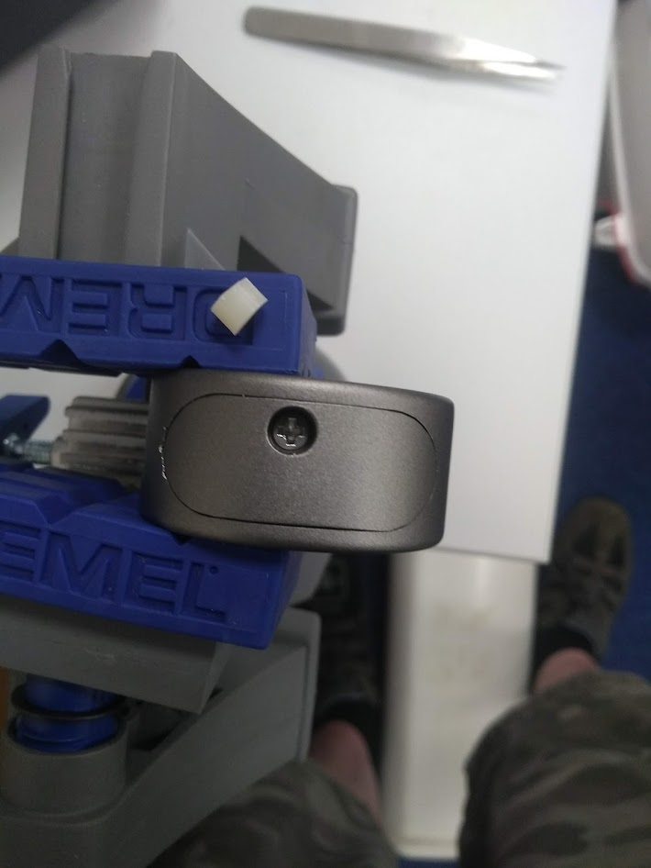
In Pictures

Slide 21
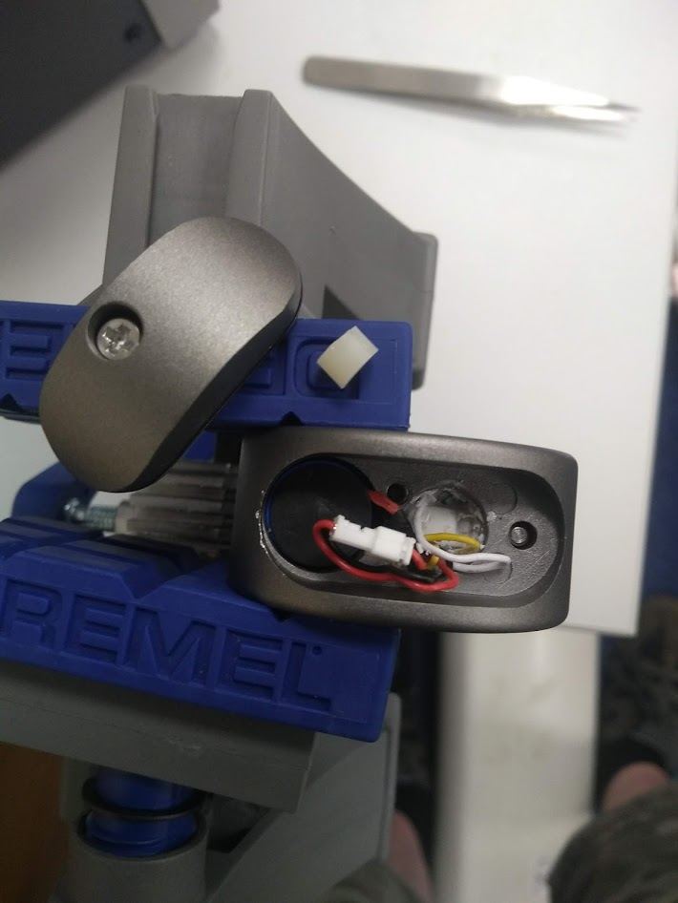
In Pictures

Slide 22
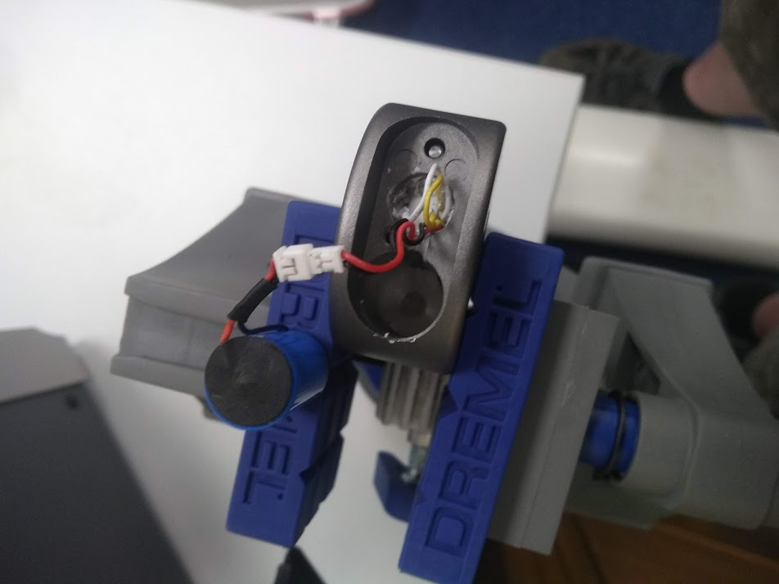
In Pictures

Slide 23
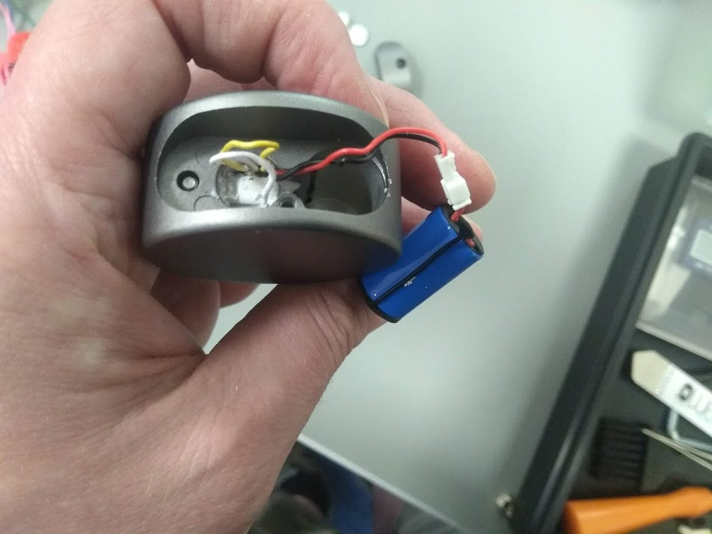
In Pictures

Slide 24
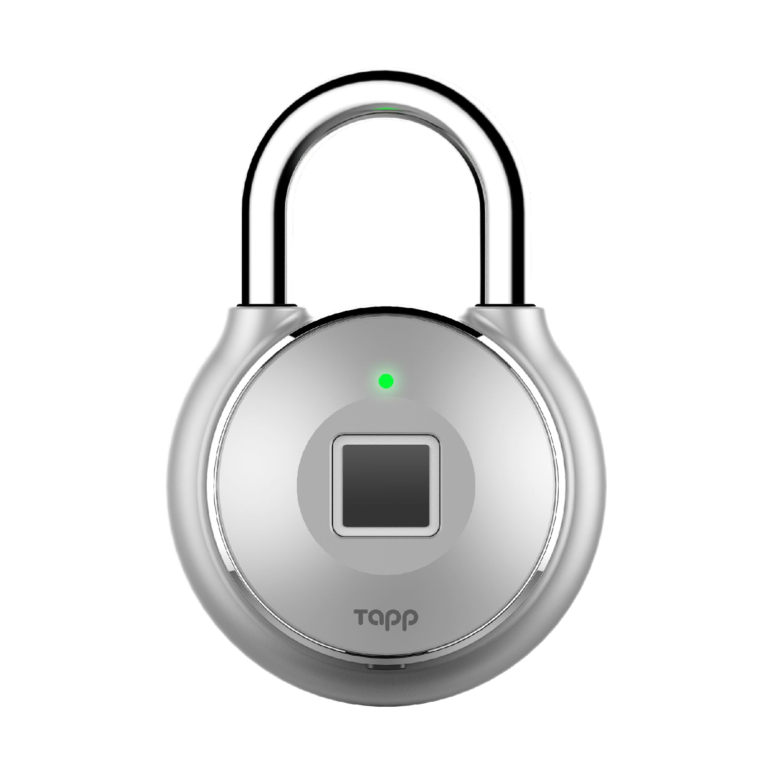
The Unlocking Sensor
The YouTuber JerryRigEverything showed how some models failed to have a pin in place and you could unscrew the back.
Uses BLE to unlock
Code is repeatable
Based on MAC address of the lock
@evstykas also noted that you can unlock via the API
https://medium.com/@evstykas/totally-pwning-the-tapplock-smart-lock-the-api-way-c8d89915f025

Slide 25
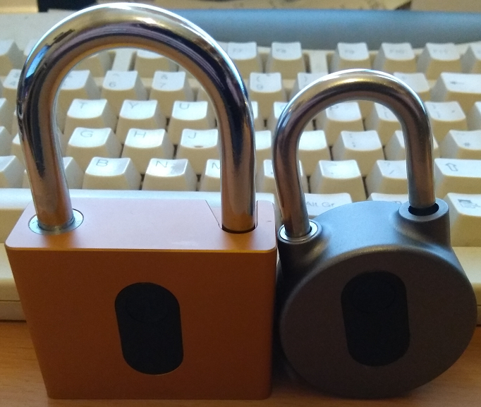
The Unlocking Sensor
Nokelock padlock (not noke)
Chinesium – can find many variants
BLE more secure than Tapplock
https://tautology.org.uk/blog/2018/07/11/reversing-the-nokelock-ble-padlock/
Notes:
Originally app wasn’t on Play is a bastard to get working

Slide 26
@tautology0

